Slide 1



PRDA-05 Customer Data Segmentation Analysis
View in Power BI
By: -
Gujari Sai Milan
Data Analyst

Slide 2
Introduction
Objective: The aim of this project is to analyze customer shopping behavior from mall data collected between 2021 and 2023. The focus is on understanding customer demographics and behavioral trends, such as gender preferences, age groups, payment methods, and their impact on revenue.
Key Focus Areas:
Analyzing customer segmentation by gender and age group.
Identifying preferred payment methods and their usage trends.
Studying revenue patterns and seasonal variations over the selected period.
Tools and Technologies:
Excel: Used for data cleaning and preparation.
Power BI: Employed for visualization and deeper insights through interactive dashboards.

Slide 3
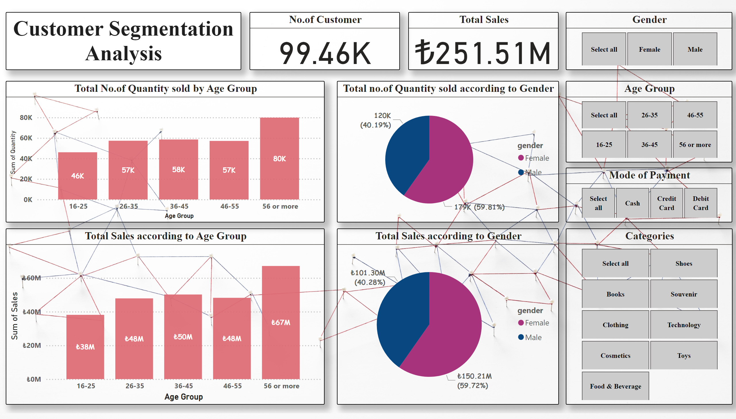
Main Page
Insights Based on Gender and Age Group

Slide 4
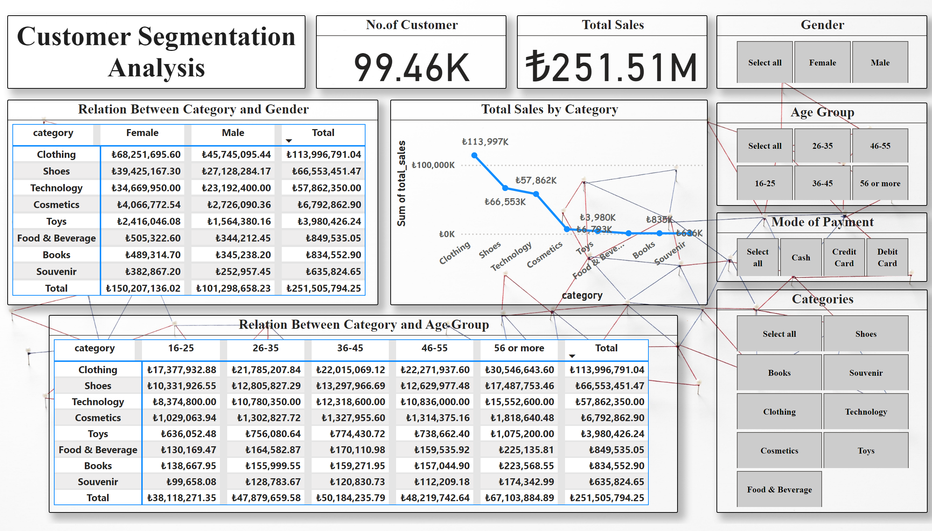
Categorical Relationship
Insights Based on Category

Slide 5
Overall theory based on Age Group, Gender, Cateogry
Demographic Insights
Age Groups:
56 or More: Highest spend (67M TL, 80k items).
16-25: Lowest spend (38M TL, 46k items); consider budget-friendly products.
Gender:
Male: 101.30M TL (40.19% of quantity sold).
Female: 150.21M TL (59.81% of quantity sold); stronger engagement in fashion and beauty.
Category Preferences
Top Categories:
Females: Clothing (68.25M TL), Cosmetics (4.07M TL).
Males: Shoes (139.43M TL), Technology (134.67M TL).
Age Group Trends:
Clothing: Popular across ages; 56+ spend 30.55M TL.
16-25: Low spending on shoes and technology.

Slide 6
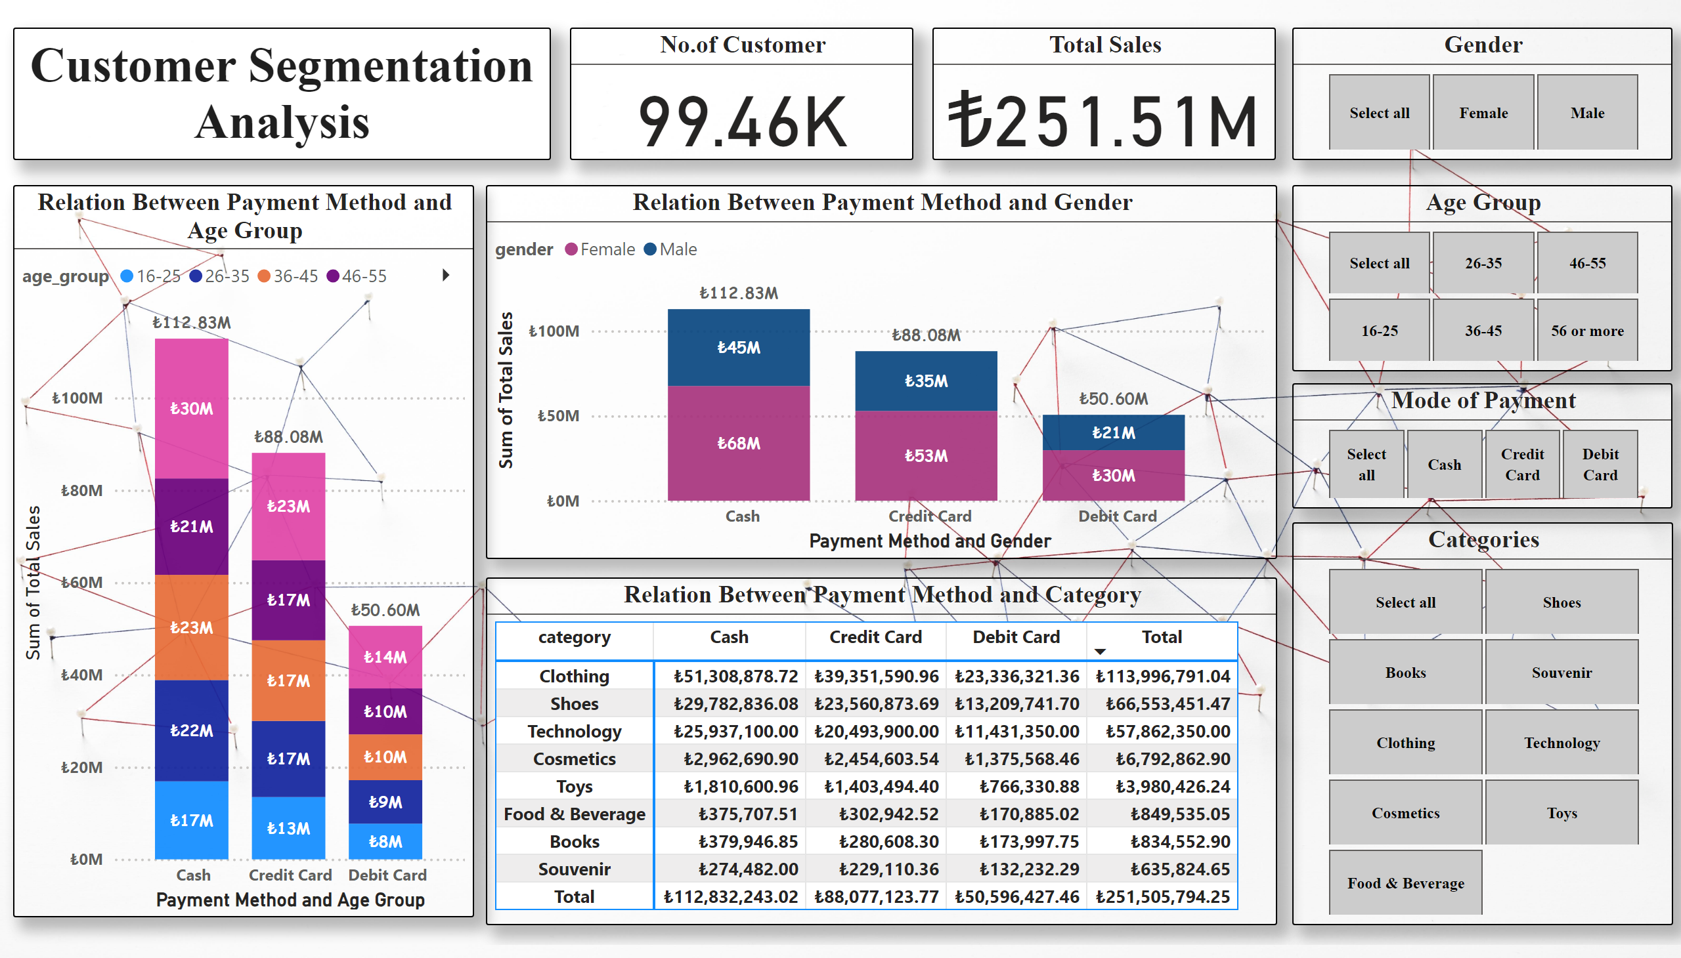
Payment Method Relationship
Overall Insights Based on Payment Method

Slide 7
Overall theory based on Age Group, Gender and Category
Payment Method and Gender
Total Sales:
Male: 101.30M TL
Female: 150.21M TL
Payment Preferences:
Females: Cash: 68M TL, Credit Card: 53M TL, Debit Card: 30M TL
Males: Cash: 45M TL, Credit Card: 35M TL, Debit Card: 50.6M TL
.Older Consumers (56 and Above):
Cash: 30M TL
Credit Card: 23M TL
Debit Card: 14M TL

Slide 8
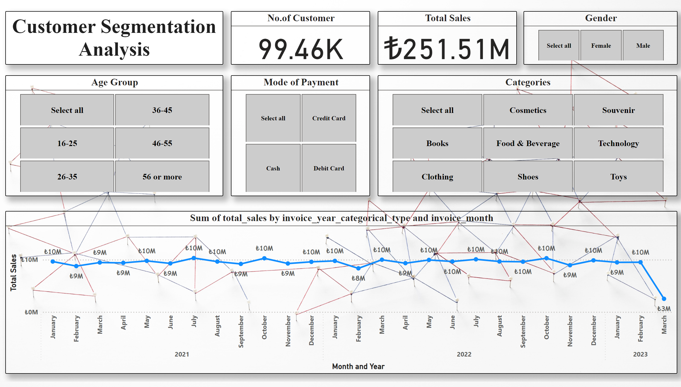
Overall Information 1
Insights based on the overall revenue throughout the years 2021,22,23

Slide 9
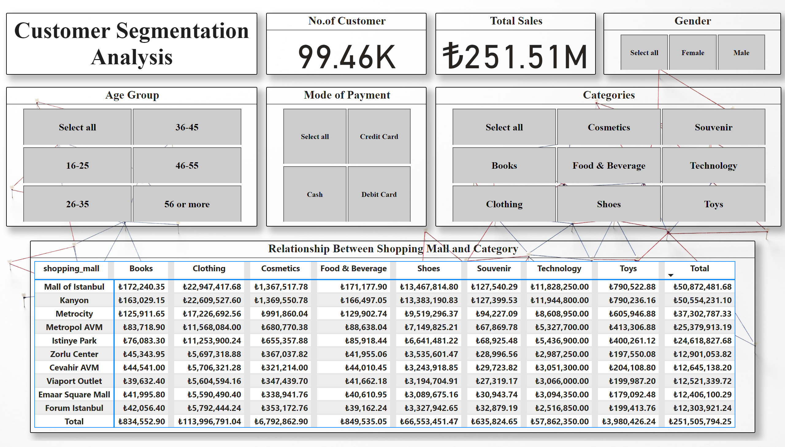
Overall Information 2
Insights Based on Shopping Mall and their Overall Revenue

Slide 10
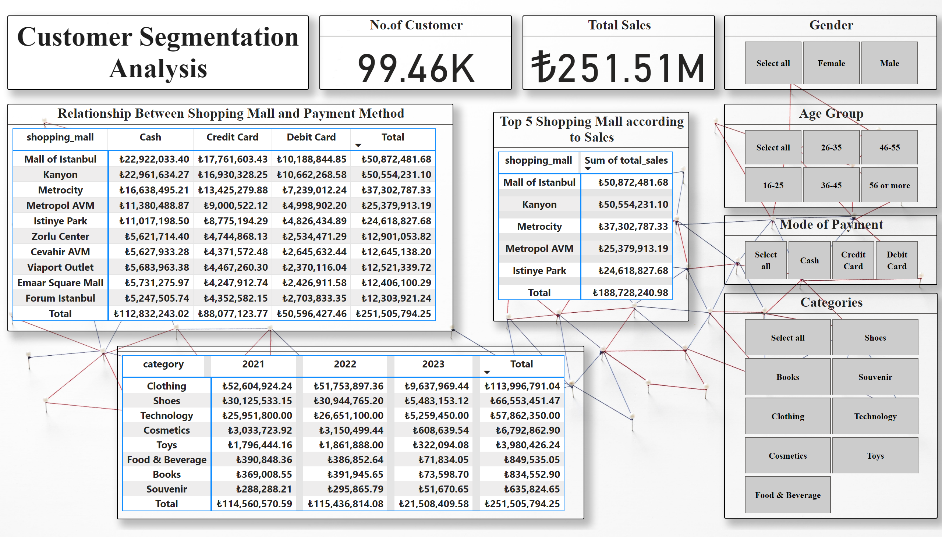
Extra Information
Final Insights regarding all the other Information

Slide 11
Overall theory based on Shopping Mall, Payment Method and Category
Shopping Mall Sales by Category
Mall of Istanbul: Leads with total sales of €50.87M, with strong performances in clothing (€22.95M) and food & beverage (€13.47M).
Kanyon: Close behind with €50.55M, primarily in clothing (€22.61M).
Metrocity: Records €37.30M, with technology sales of €19.52M.
Metropol AVM and Istinye Park follow, generating €25.38M and €24.62M, respectively.
Top Categories
Clothing: Total sales of €113.99M.
Shoes: Sales reach €66.55M.
Technology: Contributes €57.86M to total sales.
Payment Method Distribution
Total Sales by Payment Method:
Cash: €112.83M
Credit Card: €88.08M
Debit Card: €50.60M
Insights on Payment Methods
Malls favor cash transactions, particularly in Mall of Istanbul and Kanyon.
Credit and debit card usage is significant in technology and higher-value categories.

Slide 12
Final Recommendations for Growth
Optimize Inventory:
Tailor product offerings by mall based on top-selling categories, focusing on clothing and food in the Mall of Istanbul and technology in Metrocity.
Enhance Customer Engagement:
Implement loyalty programs to reward frequent cash shoppers.
Use personalized marketing based on purchasing history.
Leverage Payment Methods:
Offer incentives for cash transactions.
Promote digital payments through discounts.
Increase Foot Traffic:
Host events and collaborate with local businesses. Use social media to promote special offers and events.
Analyze Consumer Behavior:
Regularly review sales data to identify trends and adjust strategies.
Collect customer feedback to refine offerings.
Expand Product Range: Introduce new products in underperforming categories like cosmetics and toys.
Strengthen Vendor Partnerships: Collaborate with vendors for exclusive promotions to enhance customer experiences.

Slide 13

Thank You

